Slide 1

Intro GraphQL

Slide 2
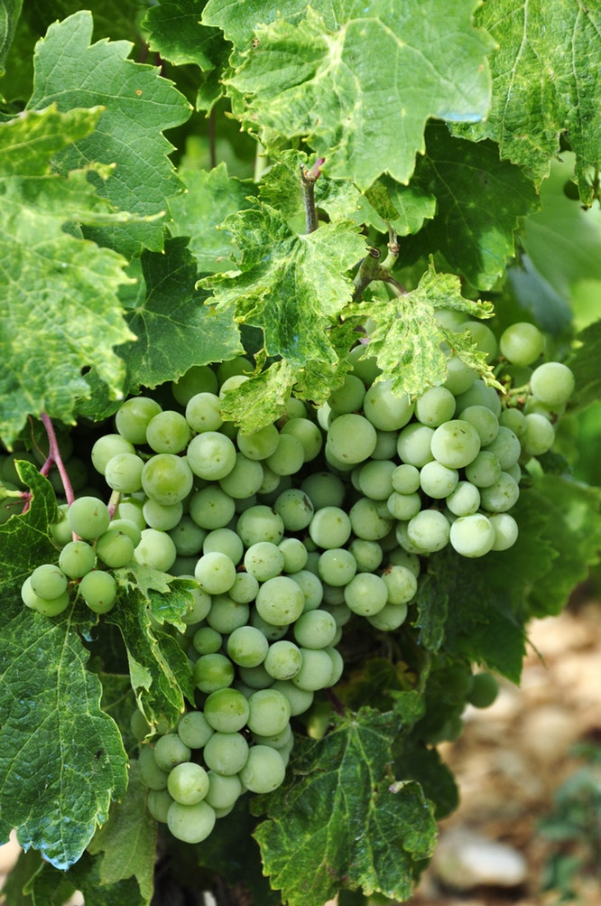
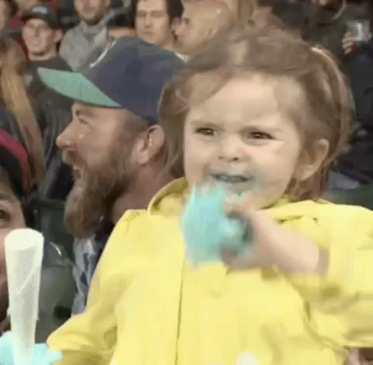
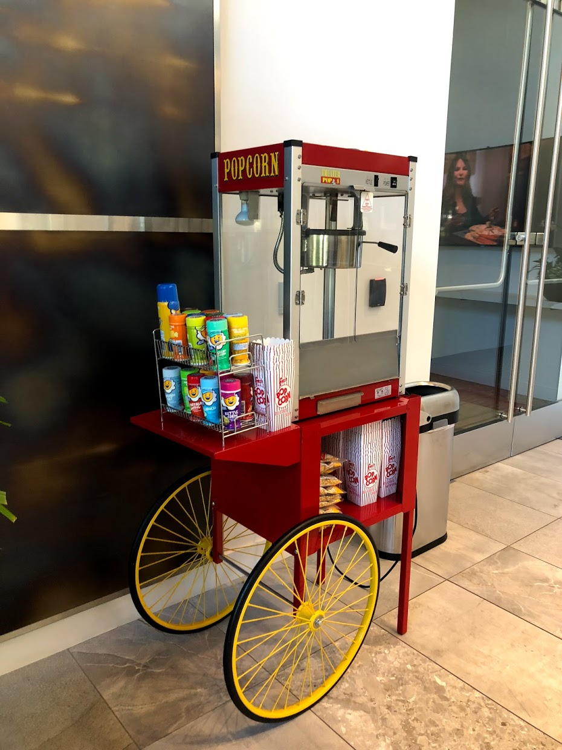

First time in California

Slide 3



Slide 4

Simona Cotin
Cloud Dev Advocate @ Microsoft
@simona_cotin

Slide 5
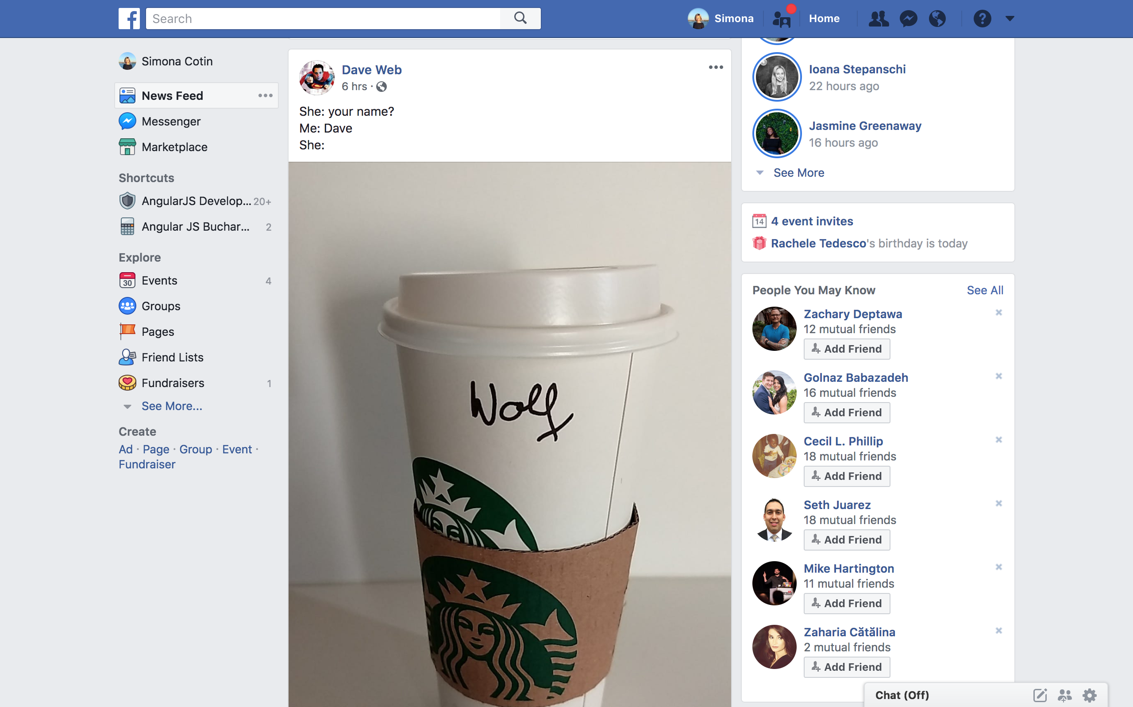

Slide 6
https://facebook.com/user/id
https://facebook.com/user/id/events
https://facebook.com/user/id/friends-suggestions
https://facebook.com/user/id/friends-birthdays

Slide 7
https://facebook.com/user/id/events
1 {
2 "name": "GraphQL",
3 "location": "Microsoft Reactor",
4 "organiser": "Devon Lindsey",
5 "size": "70",
6 "attendees": [
7 {
8 "name": "Brandon Minnik",
9 "company": "Microsoft",
10 "role": "Xamarin Chef"
11 }
12 ],
13 "..."
14 }

Slide 9
⚠️ Options
Overfetch
Add new endpoint
Notes:
Over-fetching is fetching too much data, aka there is data in the reponse you don't use.
This leads to heavier responses, You end up using more bandwidth than you should and poor UX specially on mobile. We are consuming precious data.

Slide 10
https://facebook.com/user/id/friends-suggestions
1 {
2 "mutual_friends": [
3 {
4 "name": "Mike Watson",
5 "company": "Apollo",
6 "role": "Apollo Chef",
7 "..."
8 }
9 ]
10 }
1 {
2 "firstname": "Peggy",
3 "lastname": "Rayzis",
4 "profile_pic": "some_url",
5 "..."
6 }
https://facebook.com/user/id/mutual-friends

Slide 11
⚠️ Options
Underfetch
Add new endpoint
Notes:
Under-fetching is not having enough data with a call to an endpoint, leading you to call a second endpoint.
This leads to more server roundtrips, network latency, more json parsing on the client

Slide 12
GraphQL

Slide 13
https://facebook.com/graphql 🦄
1 query {
2 user(id: "101") {
3 firstname
4 lastname
5 events {
6 count
7 }
8 friends_suggestions {
9 name
10 mutual_friends {
11 count
12 }
13 }
14 }
15 }
1 {
2 "data": {
3 "user": {
4 "firstname": "Simona",
5 "lastname": "Cotin",
6 "events": {
7 "count": "4"
8 },
9 "friends_suggestions": {
10 "name": "Zachary Deptawa",
11 "mutual_friends": {
12 "count": "12"
13 }
14 }
15 }
16 }
17 }
Notes:
The response looks very similar to the request. And that’s because we tell graphql what we want to retrieve!

Slide 14
GraphQL makes overfetching/underfetching history
Notes:
https://stackoverflow.com/questions/44564905/what-is-over-fetching-or-under-fetching/44568365#44568365
In both cases, they are performances issues : you either use more bandwidth than you should, or you are making more HTTP requests that you should.
In a perfect world, theses problems would never arise ; you would have exactly the right endpoints to give exactly the right data to your products.
Theses problems often appear when you scale and iterate on your products. The data you use on your pages often change, and the cost to maintain a separate endpoint with exactly the right data for each component becomes too much.
So you end up with a compromise between not having too much endpoints and having the endpoints fit the need best. This will lead to over-fetching in some cases (the endpoint will provide more data that you need for your specific component), and under-fetching in others (you will need to call a second endpoint).
So GraphQL fixes this problem because it allows access to an arbitrary set of data exposed by the server. You specifically specify what you need and will get this data, and only this data, in one trip to the server.

Slide 15
🦄
Realtime documentation
Static analysis of queries
Typed API

Slide 16
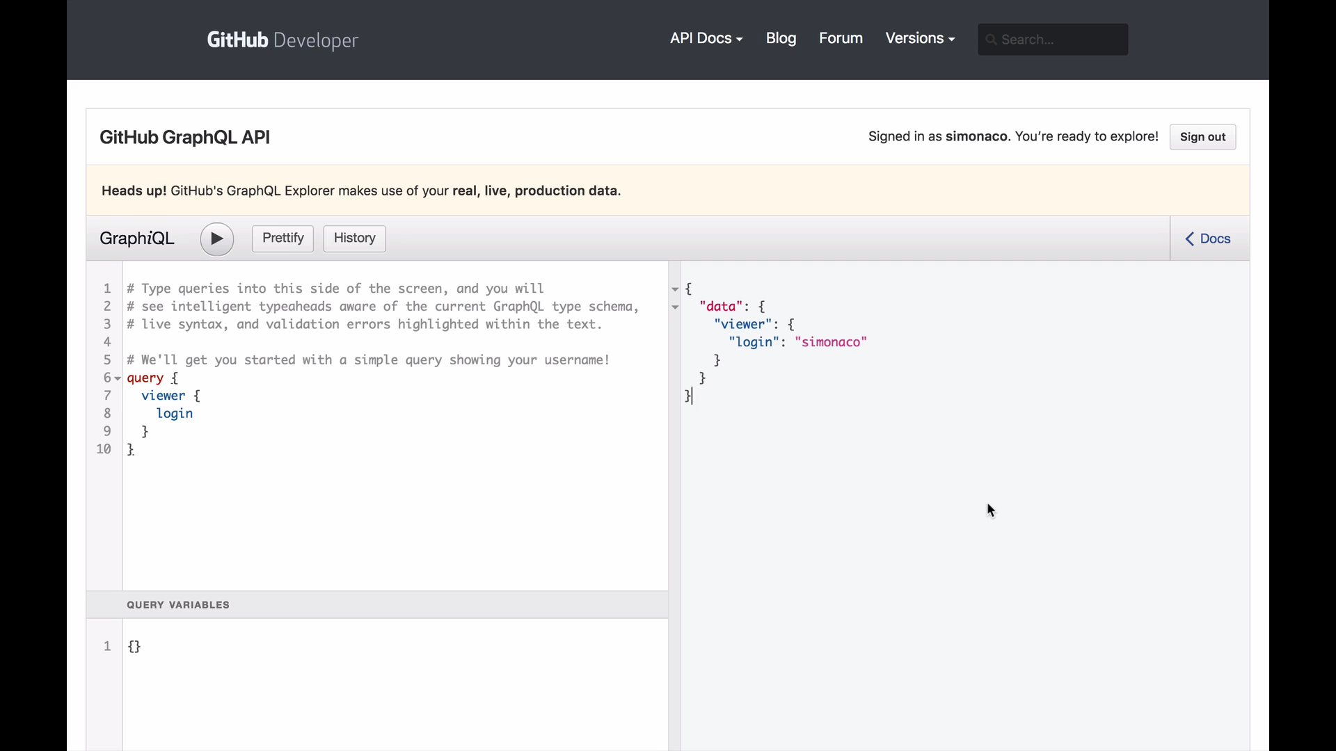
Realtime documentation
Notes:
https://developer.github.com/v4/explorer/

Slide 17
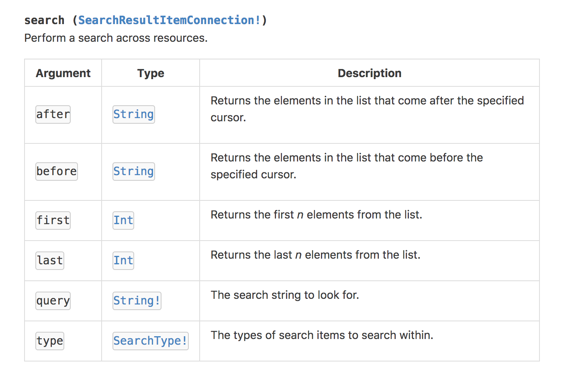
Typed API

Slide 18
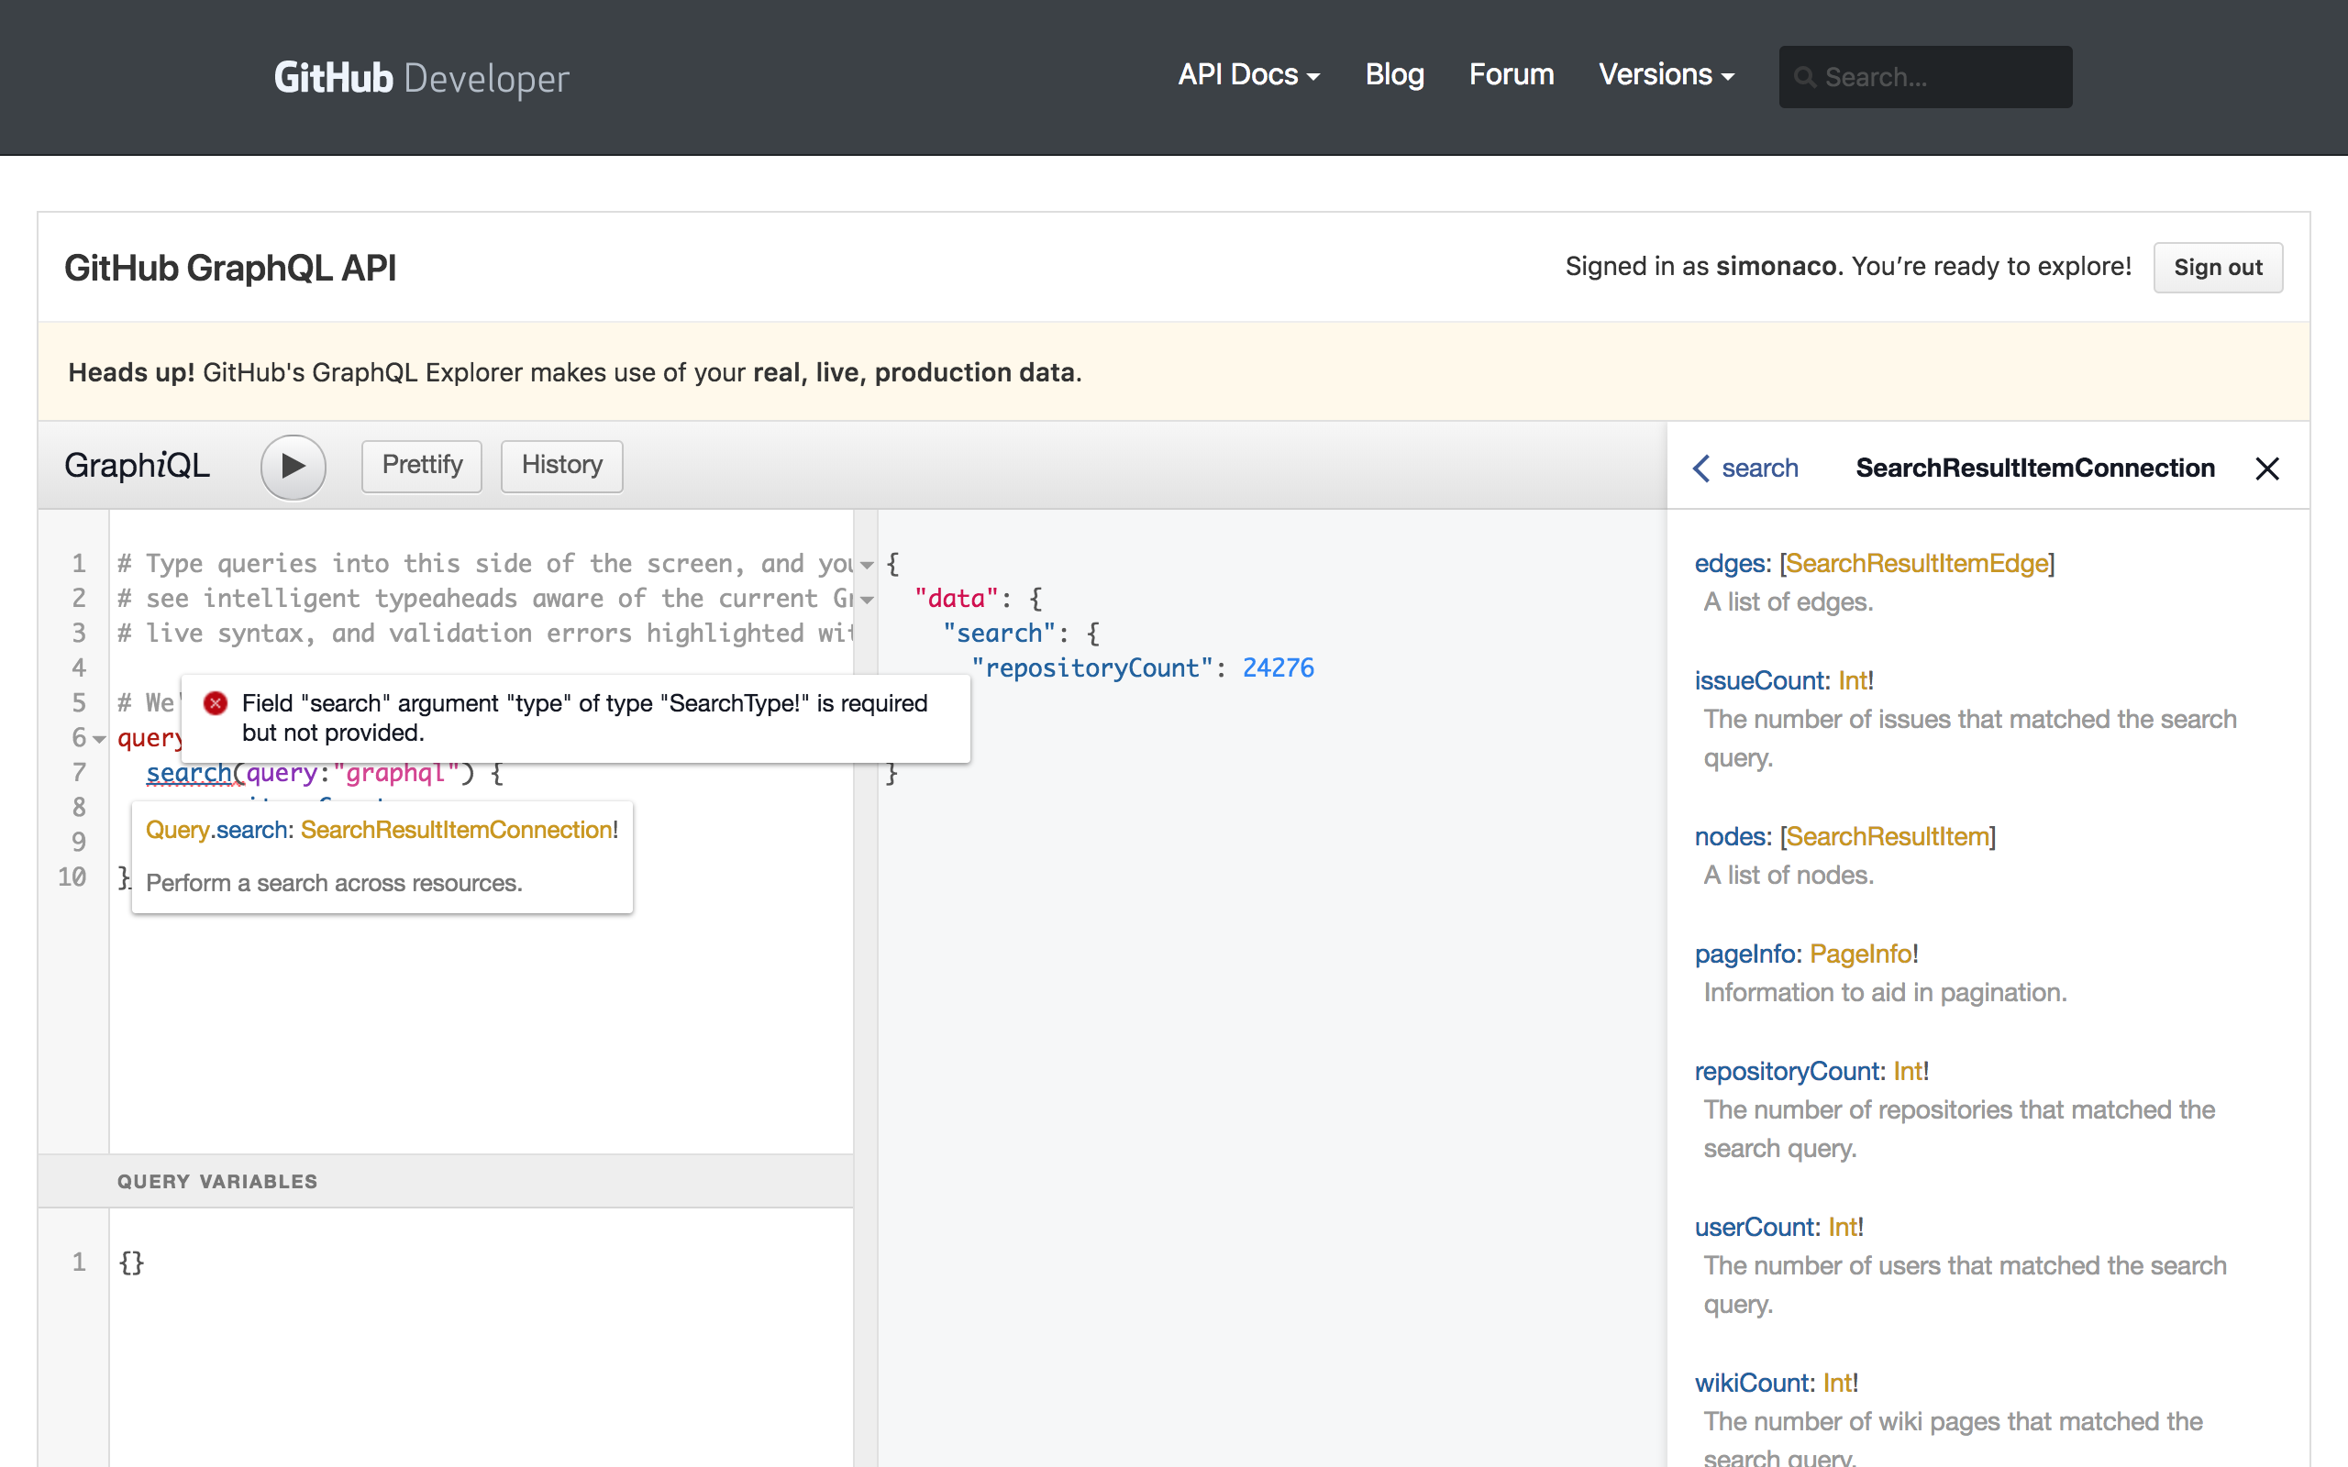
Static analysis of queries

Slide 19
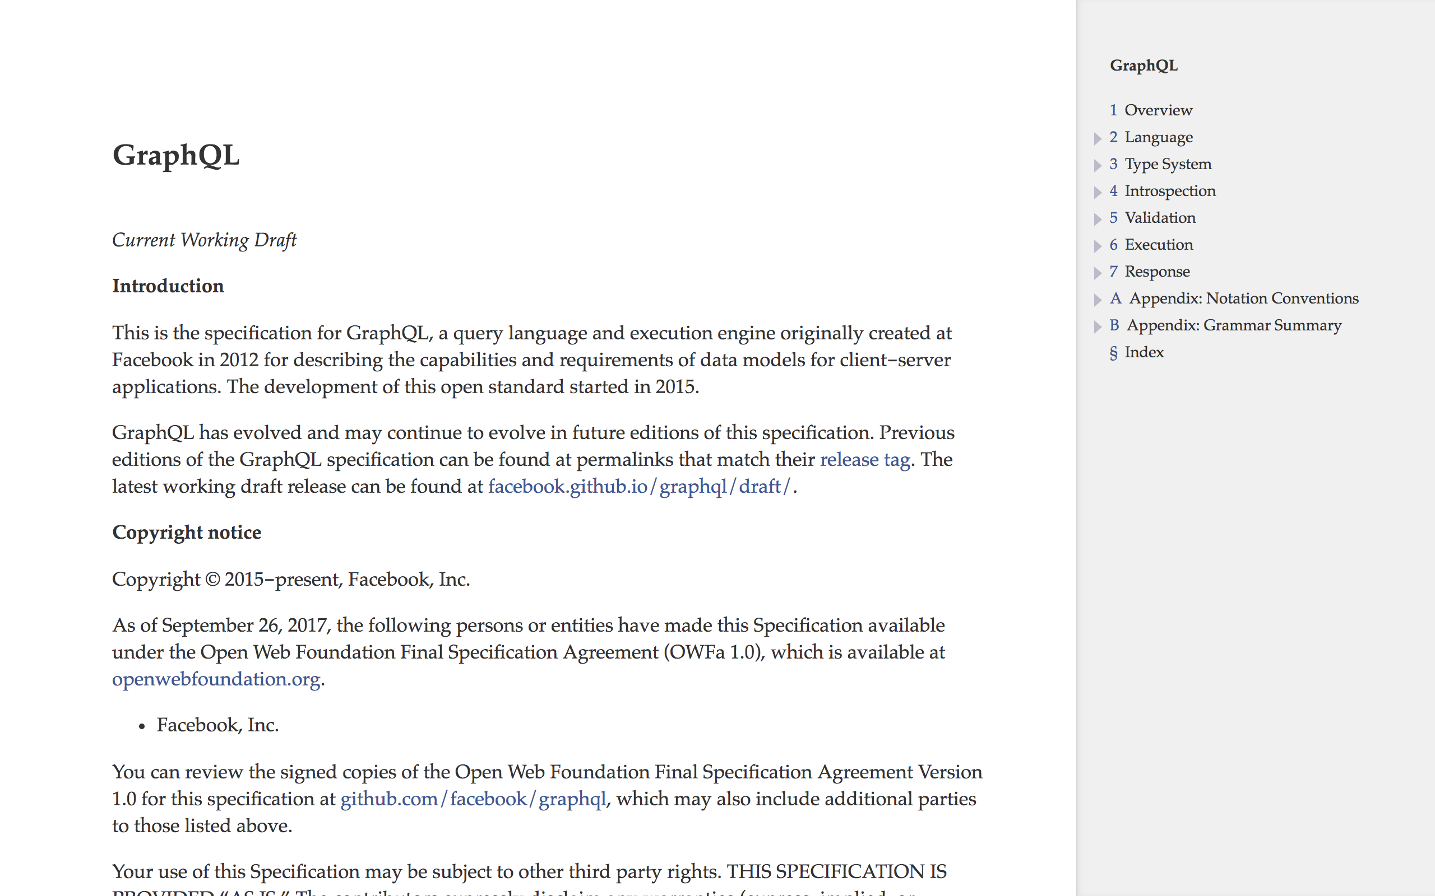
https://facebook.github.io/graphql/draft/

Slide 20


Notes:
https://www.apollographql.com/
https://facebook.github.io/relay/

Slide 21
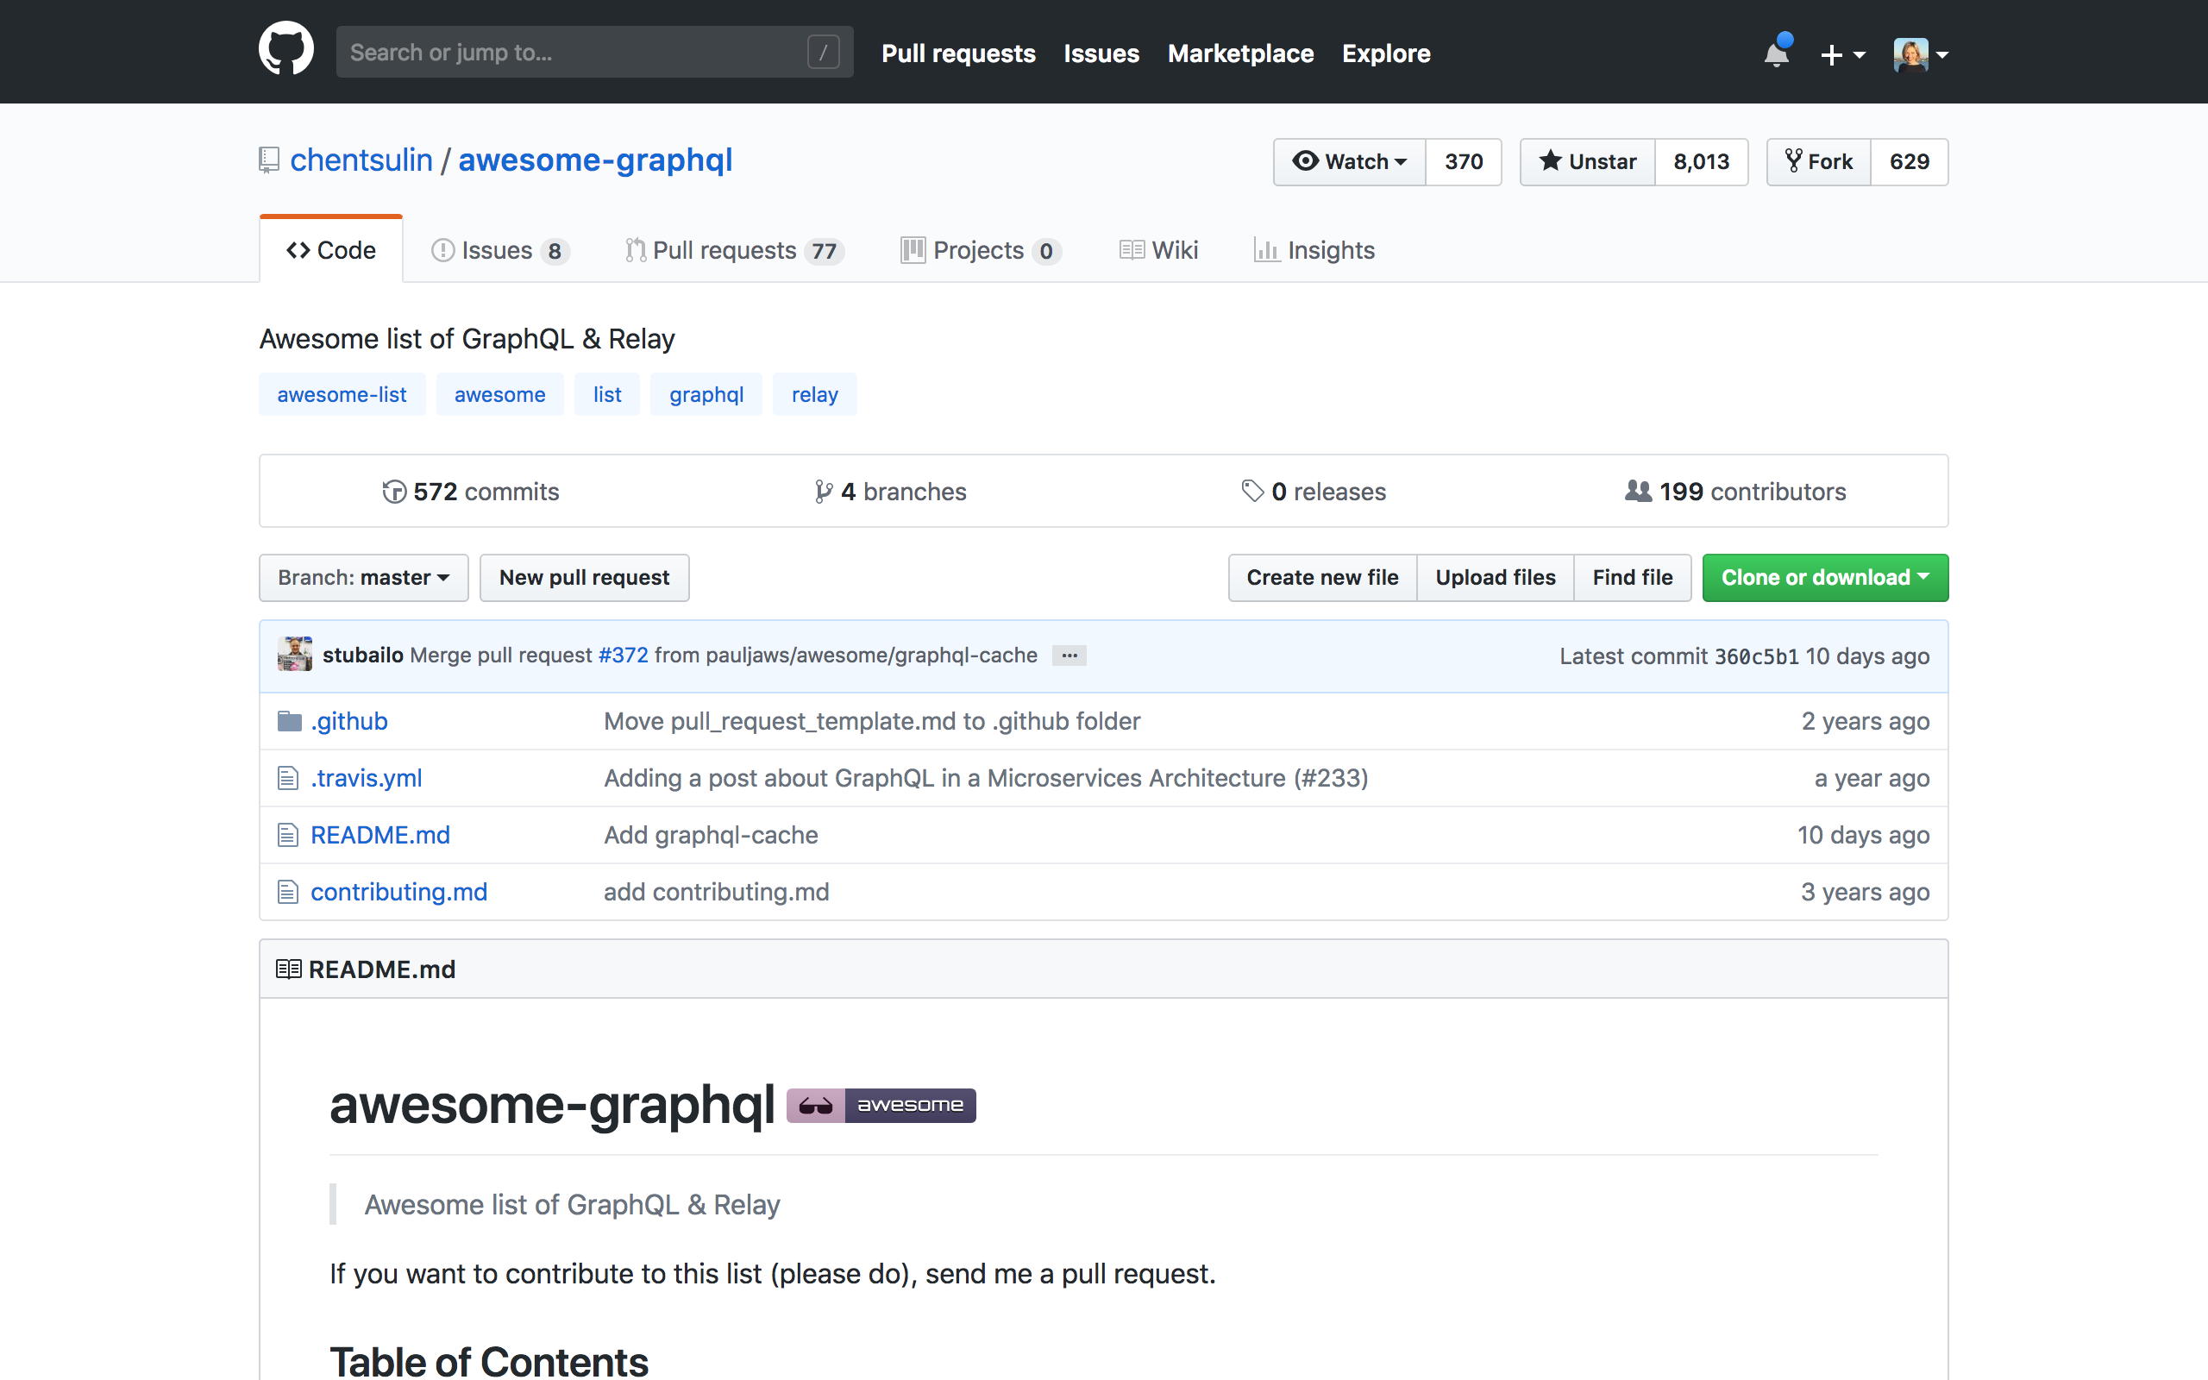
https://github.com/chentsulin/awesome-graphql

Slide 22

QUERIES
Notes:
GET request

Slide 23
1 {
2 "data": {
3 "teams": [
4 {
5 "name": "red",
6 "points": 232
7 },
8 {
9 "name": "green",
10 "points": 255
11 }
12 ]
13 }
14 }
1 query {
2 teams {
3 name
4 points
5 }
6 }

Slide 24
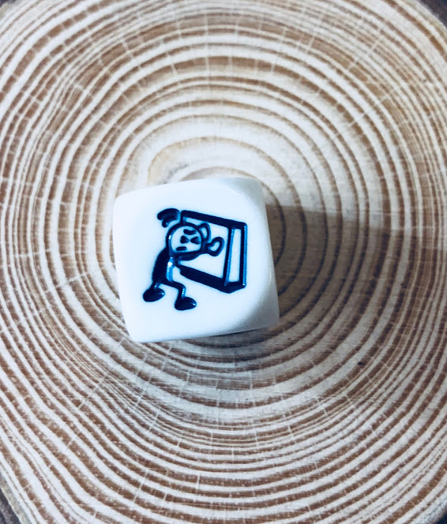
MUTATIONS
Notes:
POST PUT method

Slide 25
1 {
2 "data": {
3 "incrementPoints": {
4 "id": "2",
5 "name": "green",
6 "points": 256
7 }
8 }
9 }
1 mutation {
2 incrementPoints(id:2) {
3 id
4 name
5 points
6 }
7 }
Notes:
Add mutation queries

Slide 26

Notes:
https://github.com/simonaco/voting-app

Slide 27

Thank you!!!

